Slide 1
NeoWs API Testing - Team π

Slide 2
Team Introduction
Jonathan Delemos - Team Lead
Math Instructor, Senior CS
Legna Saca Archuleta - Senior CS
Mohammad Imrose - Web Development Intern,
Senior CS
CJ Pallari - Senior CS
Katerina Cowan - Apple, Senior CS

Slide 3
Project Aim
Model
Create a model of the API we are testing.
Design
Create test cases based on mathematics.
Execute
Run the designed test cases and gather data.
Analyze/Report
Examine data and report findings to the client.

Slide 4
Background Research
NASA API Repository
Lecture Materials
We dove into the NASA repository and carefully examined each API available. After our analysis, we determined NeoWs to be the best suited for our task.
With the lecture materials and repository, we were able to use our general programming skills to develop a functional program for testing.

Slide 5
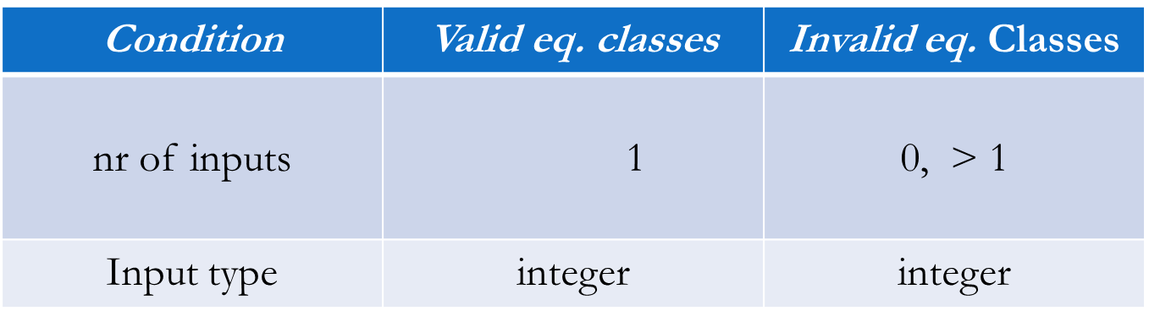
API Testing Method/Results

Slide 6
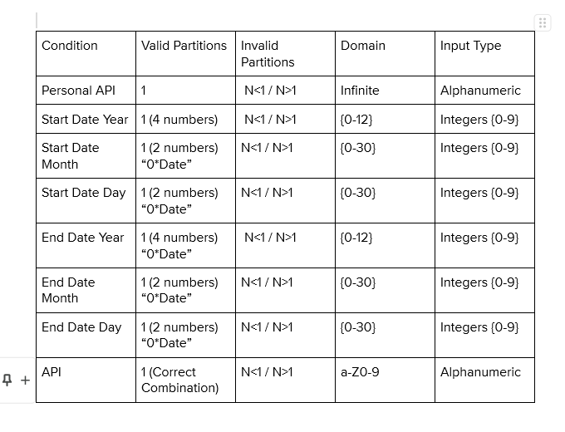
API Test Case Model
Our goal was to create a testing hypothesis for each input parameter, then modify the hypothesis based on the results we gathered.

Slide 7
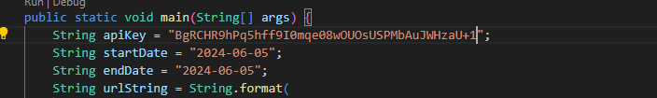
Personal Key - N+1 - Tests
Here, we see the API key being changed by the model design.

Slide 8
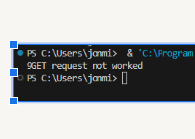
Personal Key - N+1- Results

Slide 9
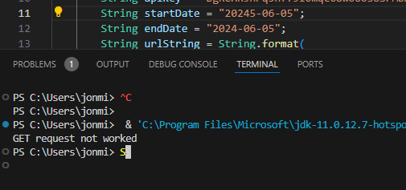
Start Date- YYYY - N+1 -Test/Results

Slide 10
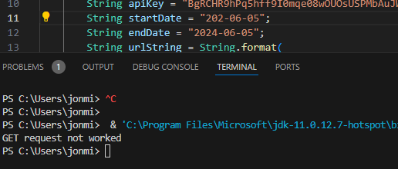
Start Date - YYYY - N-1 -Test/Results

Slide 11
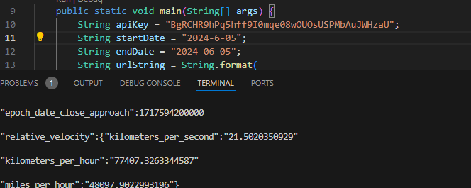
Start Date - MM - N-1 ACCEPTED -Test/Results
Edge Case

Slide 12
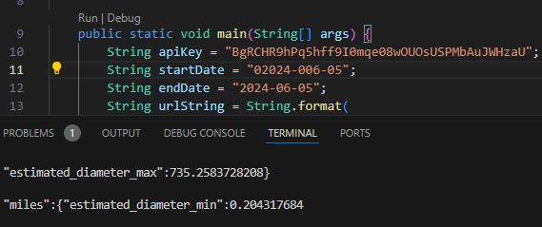
Start Date - MM - N+1 ACCEPTED -Test/Results
Edge Case

Slide 13
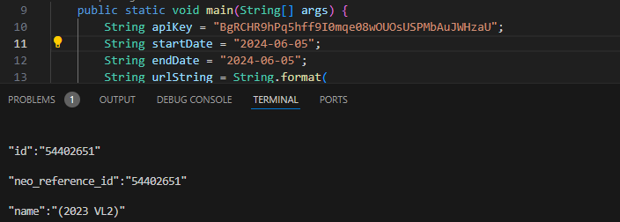
Start Date - MM - N -Test/Results

Slide 14
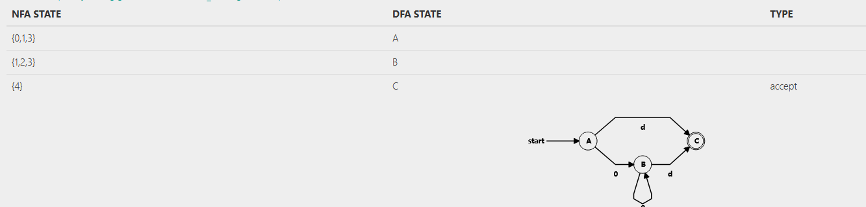
Conclusion/Analysis
For the purpose of this API testing, we identified valid partitions for the API. In testing, we were able to find infinite string variations of acceptable partitions. As an example, we will display a DFA to express our findings. (0 is 0, d = date)
In conclusion, we were successful in defining the boundaries of this API and its potential edge cases.

